Slide 1
Data Visualisation and Dimensionality Reduction

Slide 2
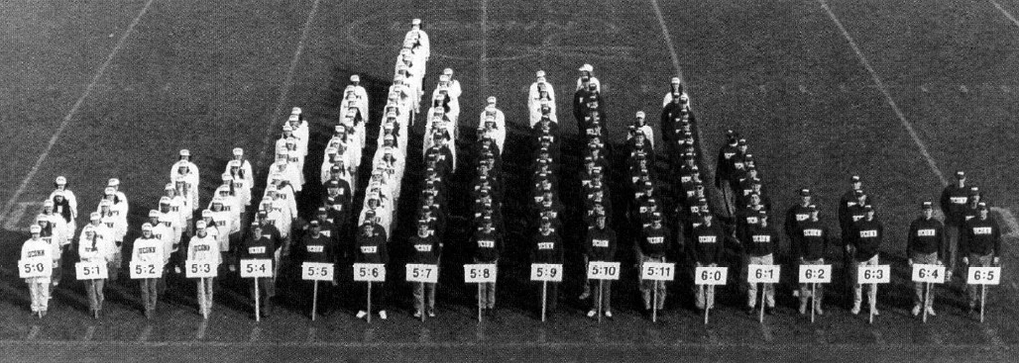
Histograms
Estimate density in a discrete way
Define cut points and count occurrences within bins
How to choose cut points
  equal width: cut domain (min->max) up in k equal size intervals
  equal height: select k cut points such that all bins contain (approximately) n/k data points (maximises entropy)
equal width

Slide 3
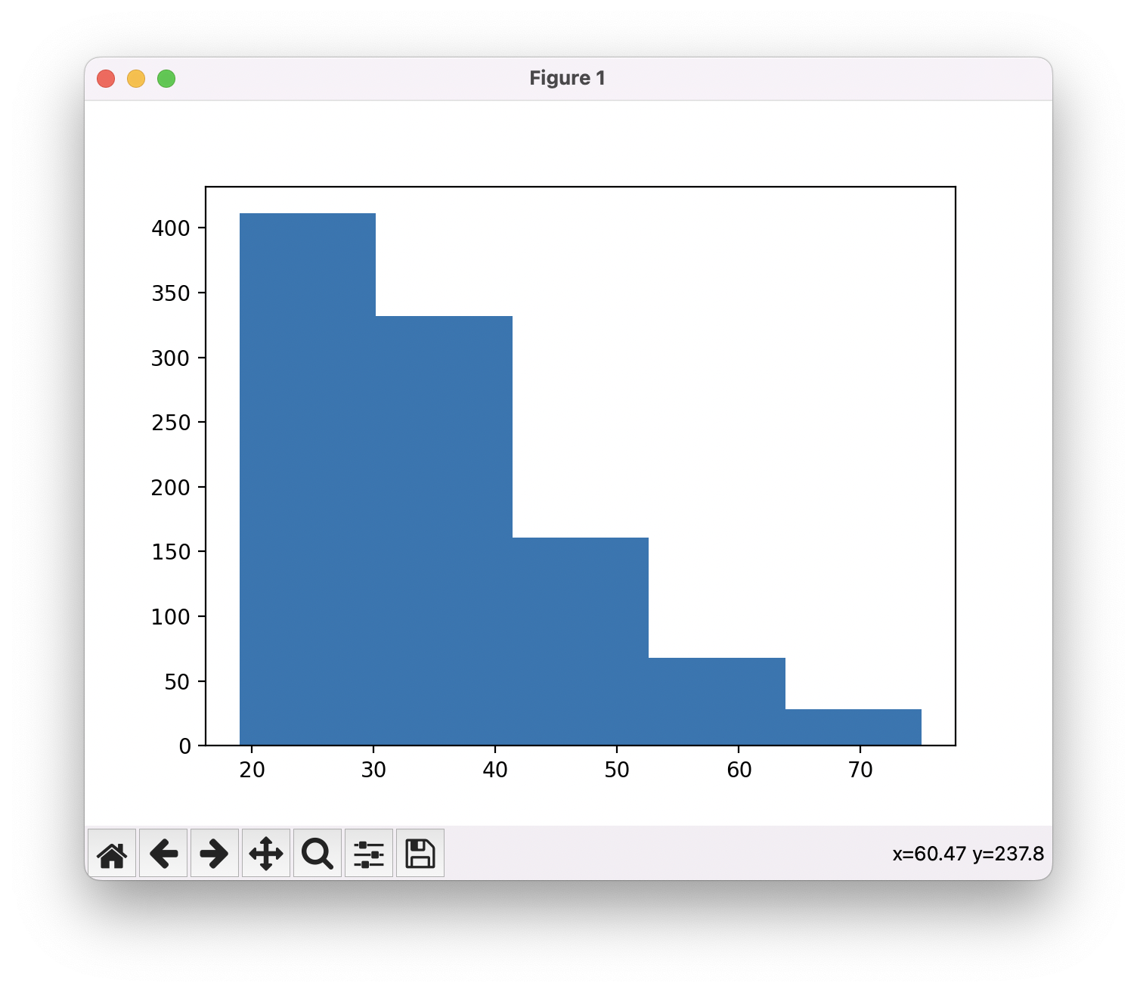
Histograms (EW, bins = 5)
age distribution in German Credit Data (UCI)

Slide 4
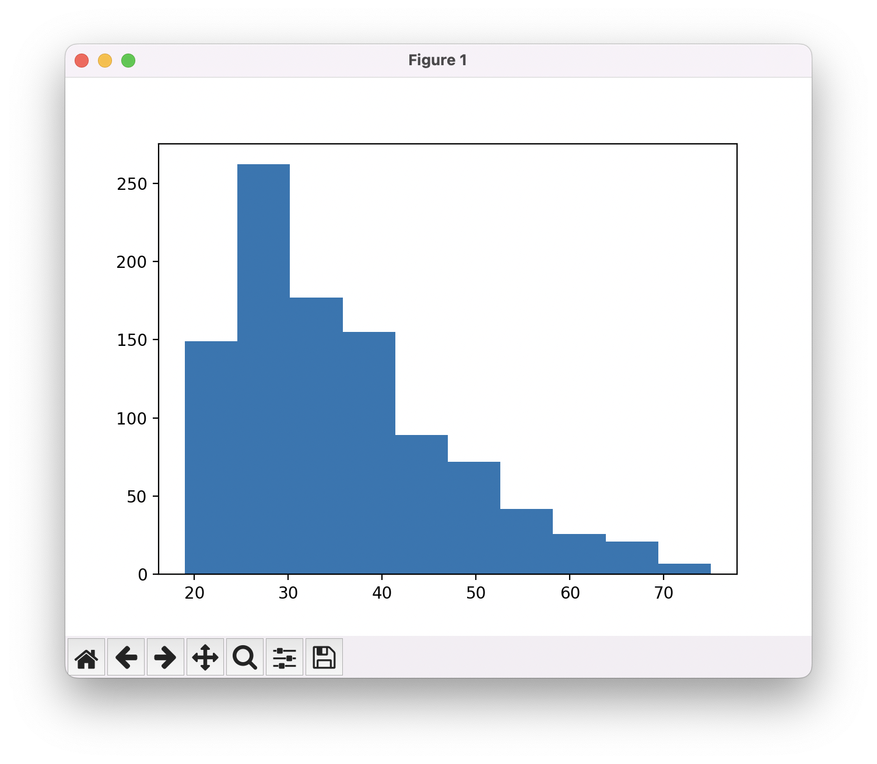
Histograms (bins = 10)

Slide 5
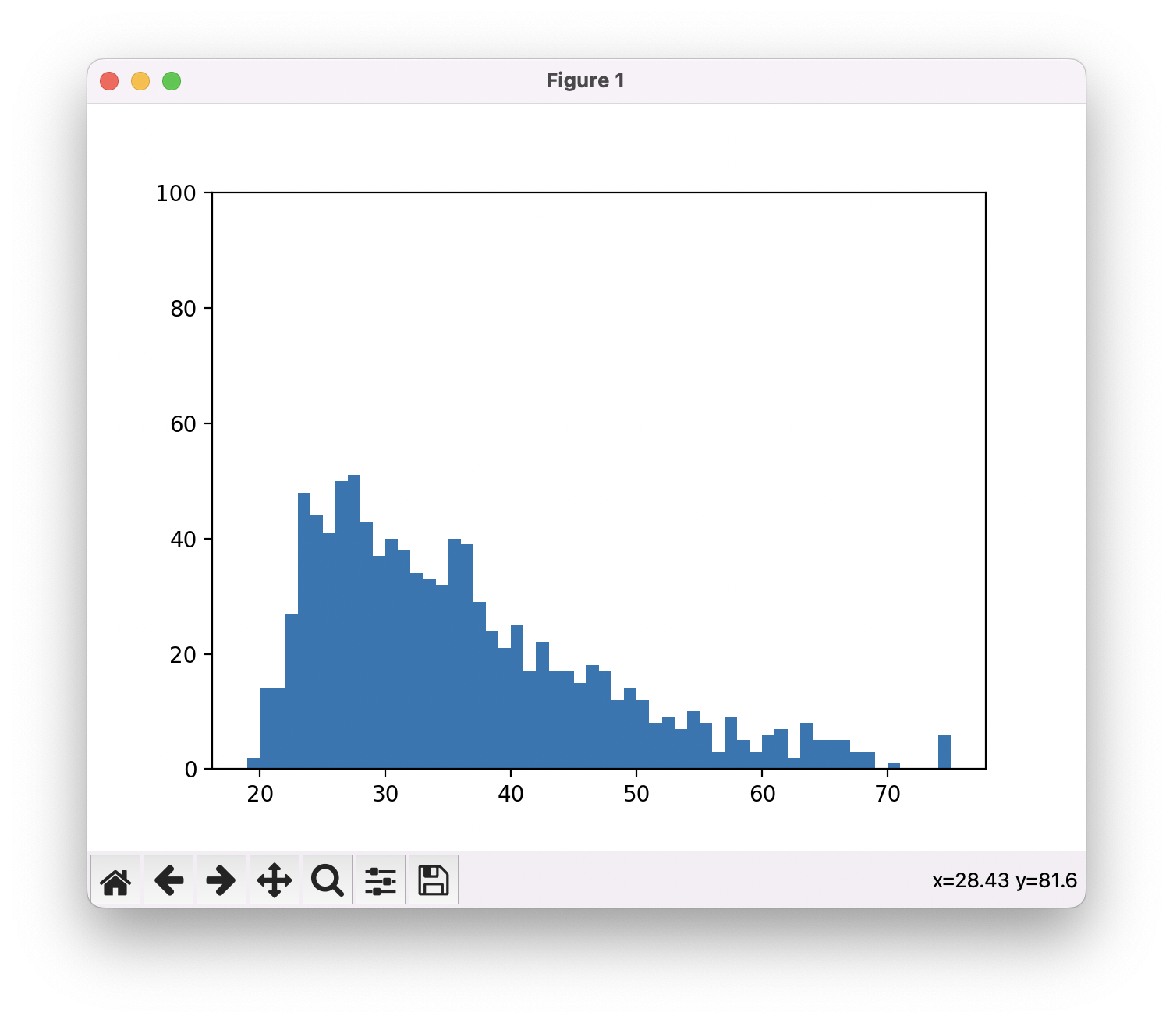
Histograms (bins = 56)

Slide 6
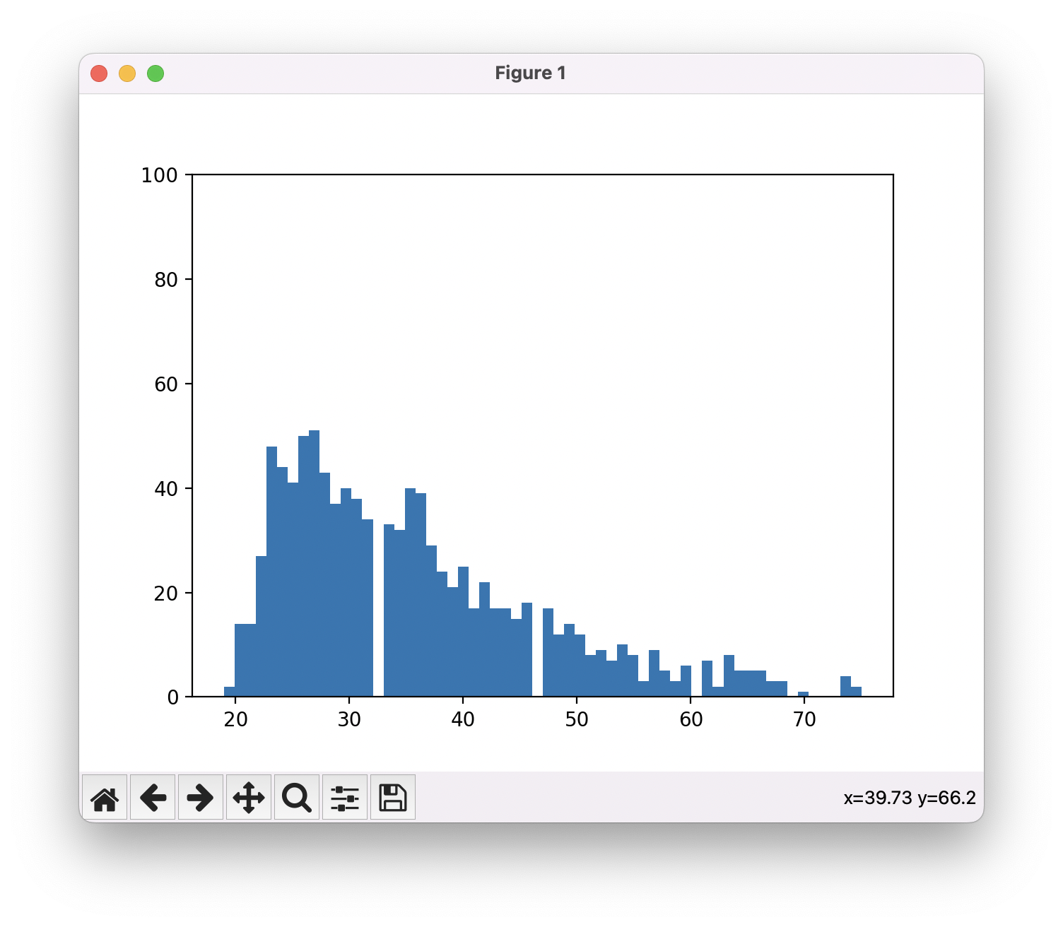
Histograms (bins = 60, +4)
4 artefacts

Slide 7
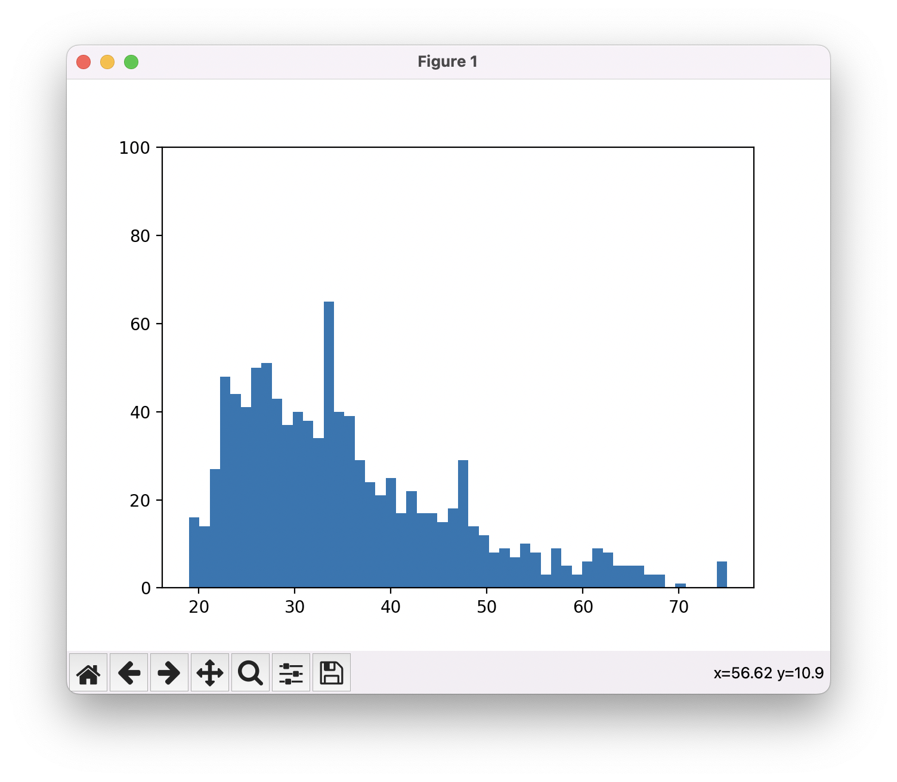
Histograms (bins = 52, -4)
4 artefacts

Slide 8
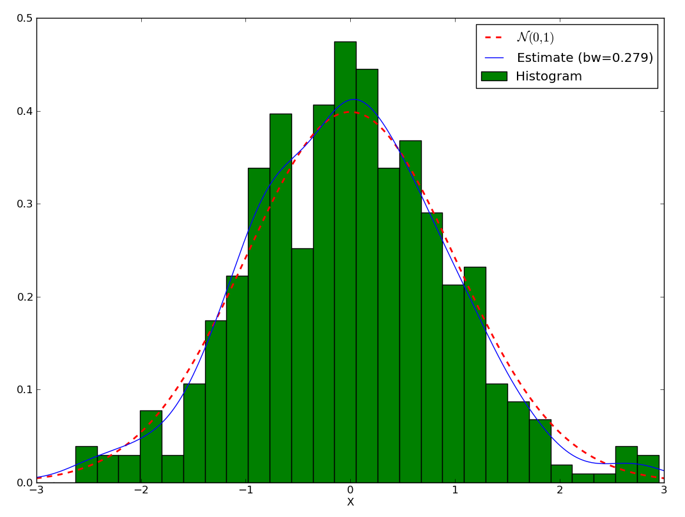
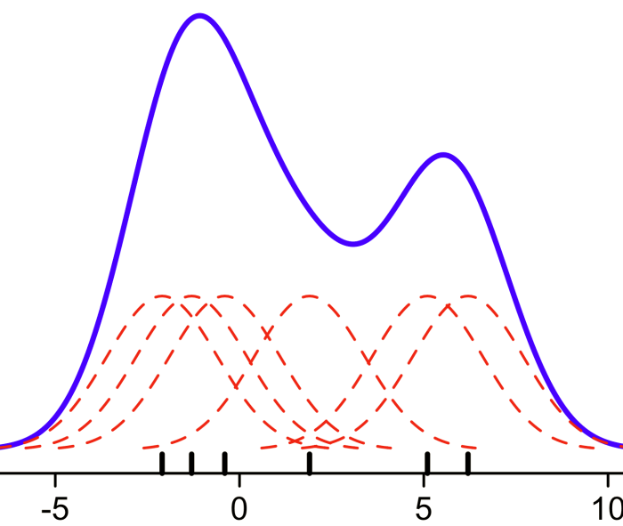
Kernel Density Estimation
Estimating the density (of the population) from the sample
Observed data is smoothed over numeric domain by means of a kernel (often Gaussian)

Slide 9
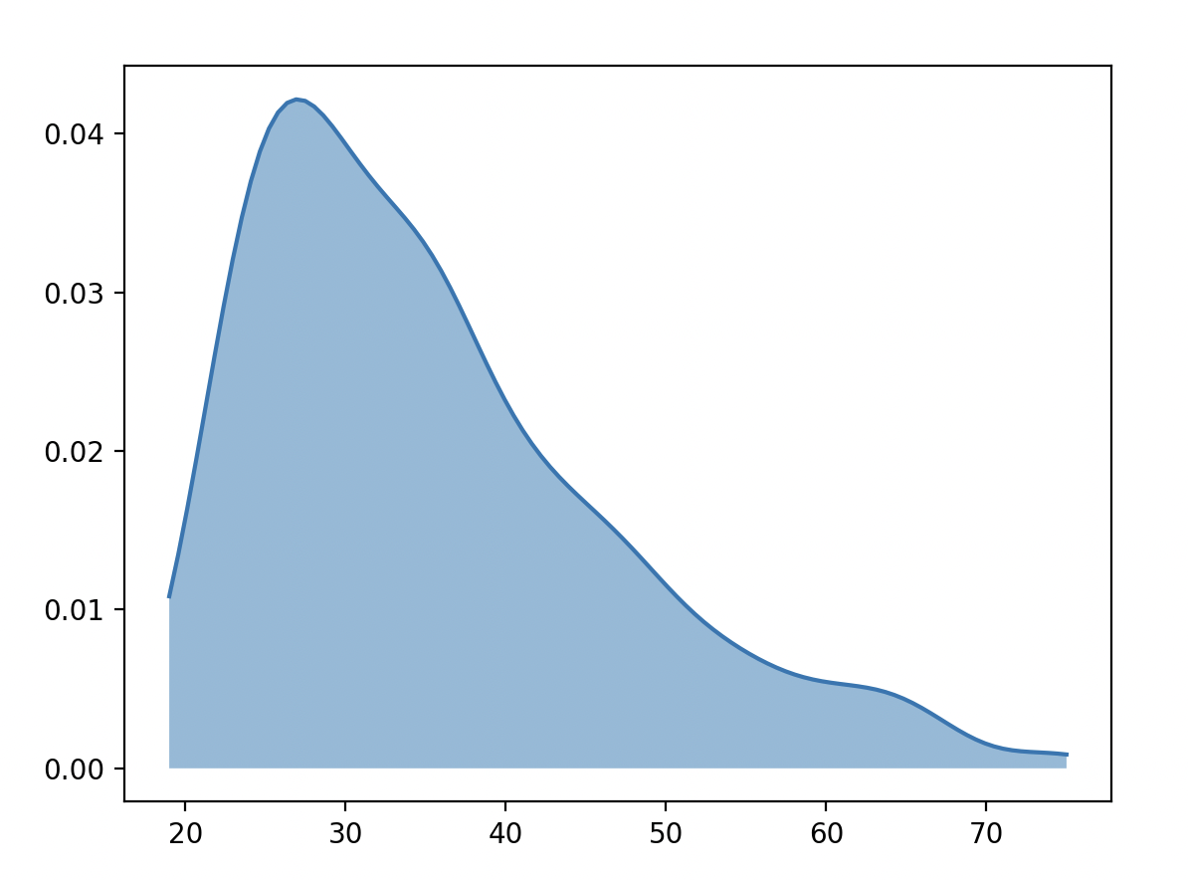
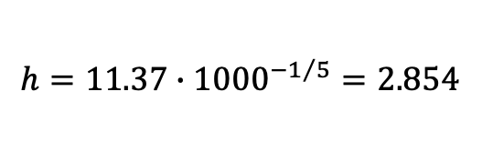
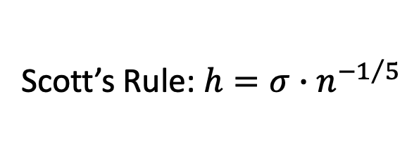
Guessing the Right Bandwidth h in KDE
Scott’s Rule: $h={σ∙n}^{−1/5}$
$$h=11.37∙{1000}^{−1/5}=2.854$$
Notes:
Scott’s and Silverman rule are more complex with higher dimensions. These formulas are just for d = 1

Slide 10
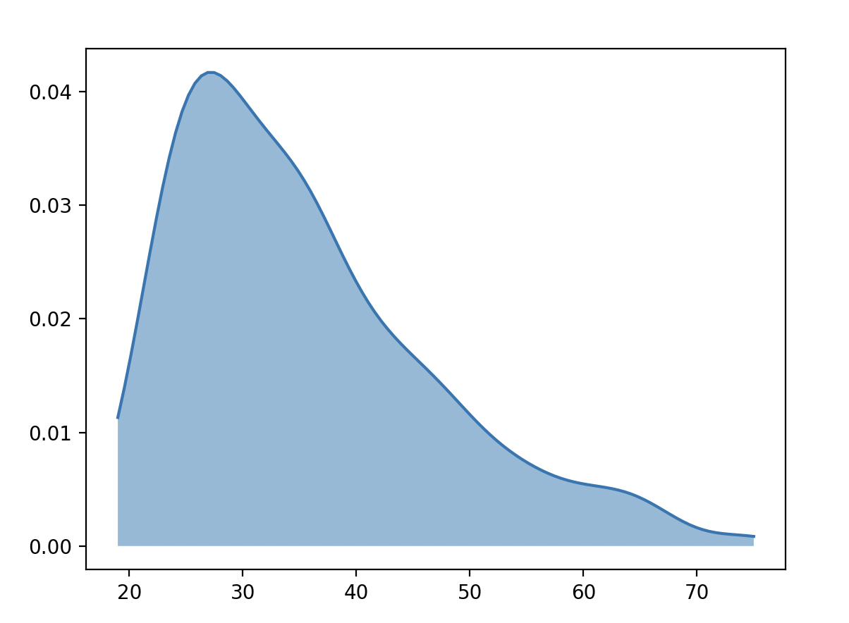
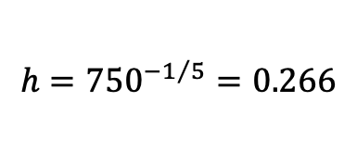
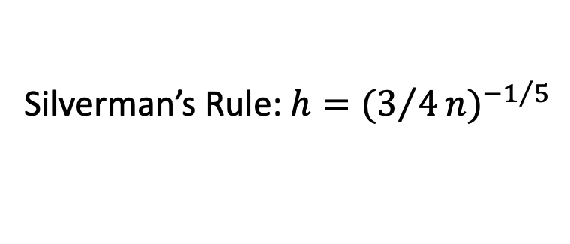
Guessing the Right Bandwidth h in KDE
Silverman’s Rule: $h={(3/4n)}^{−1/5}$
$$h={750}^{−1/5}=0.266$$

Slide 11
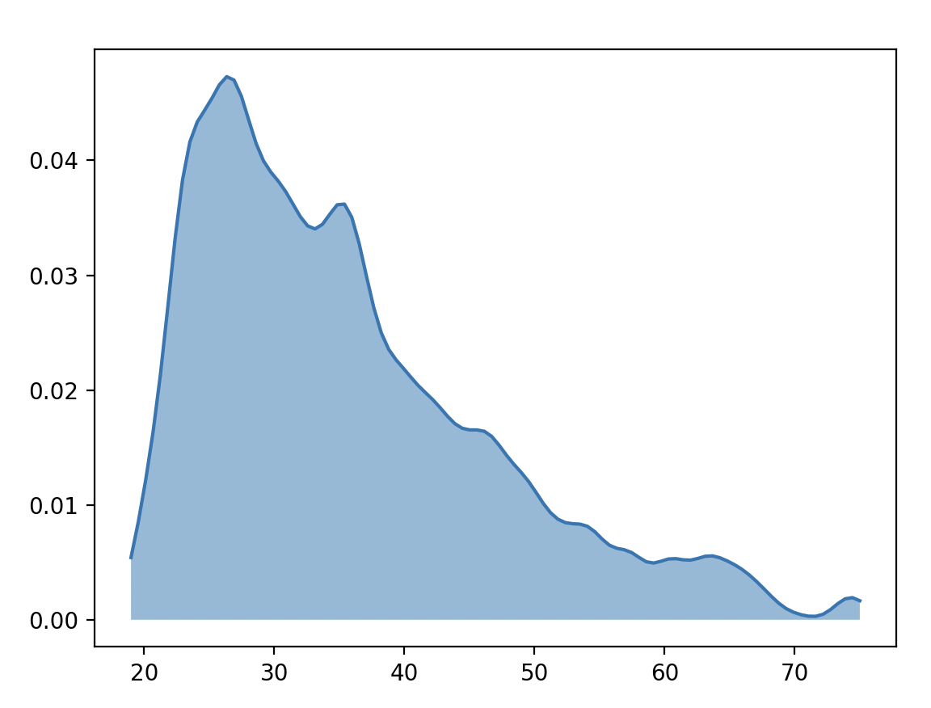

Smaller Bandwidths
$$h=0.1$$

Slide 12
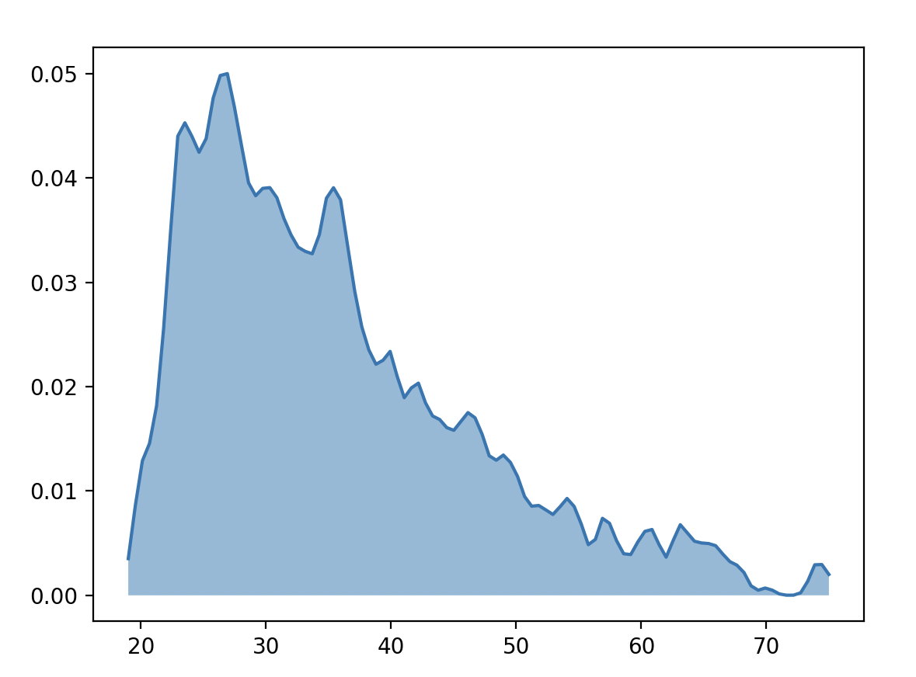

Kernel Density Estimate
$$h=0.05$$

Slide 13
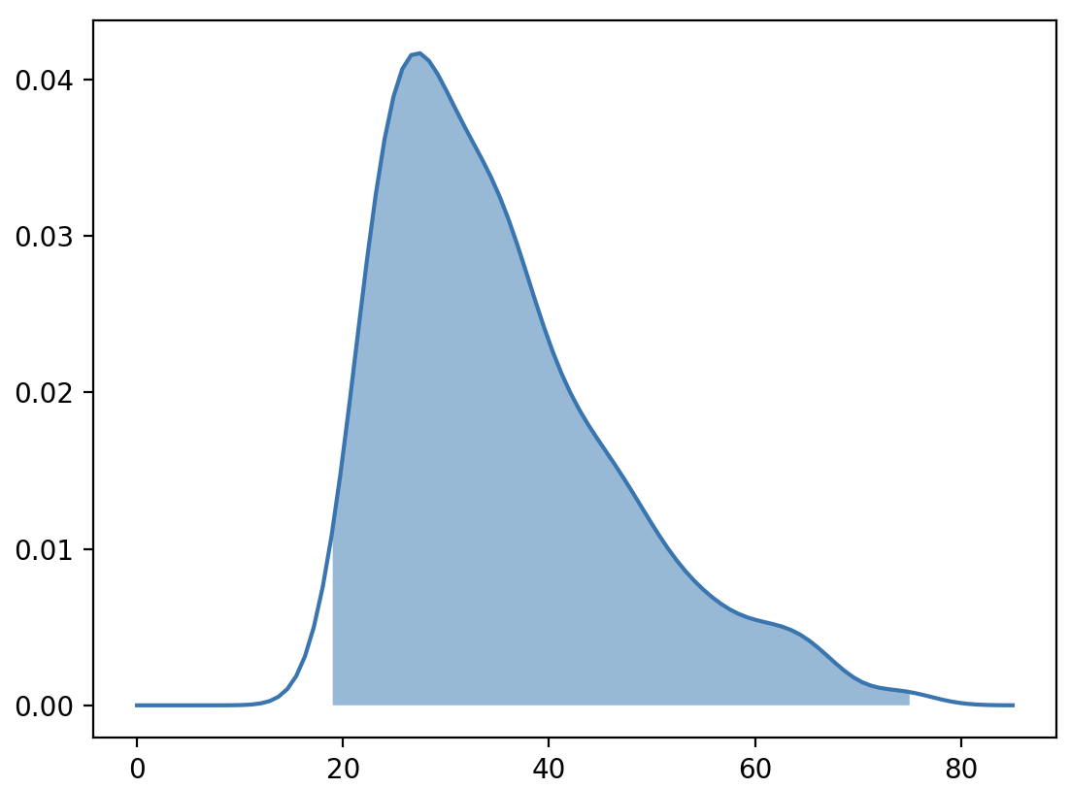
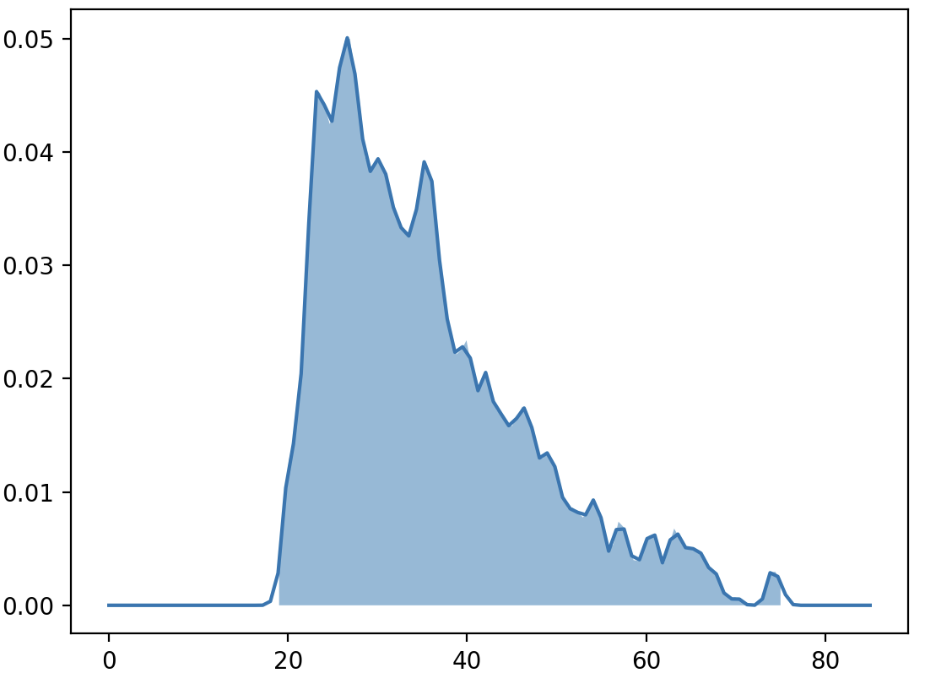
KDE Artefacts
KDE builds on the assumption that datapoints have measurement error
Min and max in the sample are perhaps not the extreme values in the population
KDE will be wider than the range of the data
Size of artefact depends on bandwidth

Slide 14
Race Times in Speed Skating
track
record

Slide 15
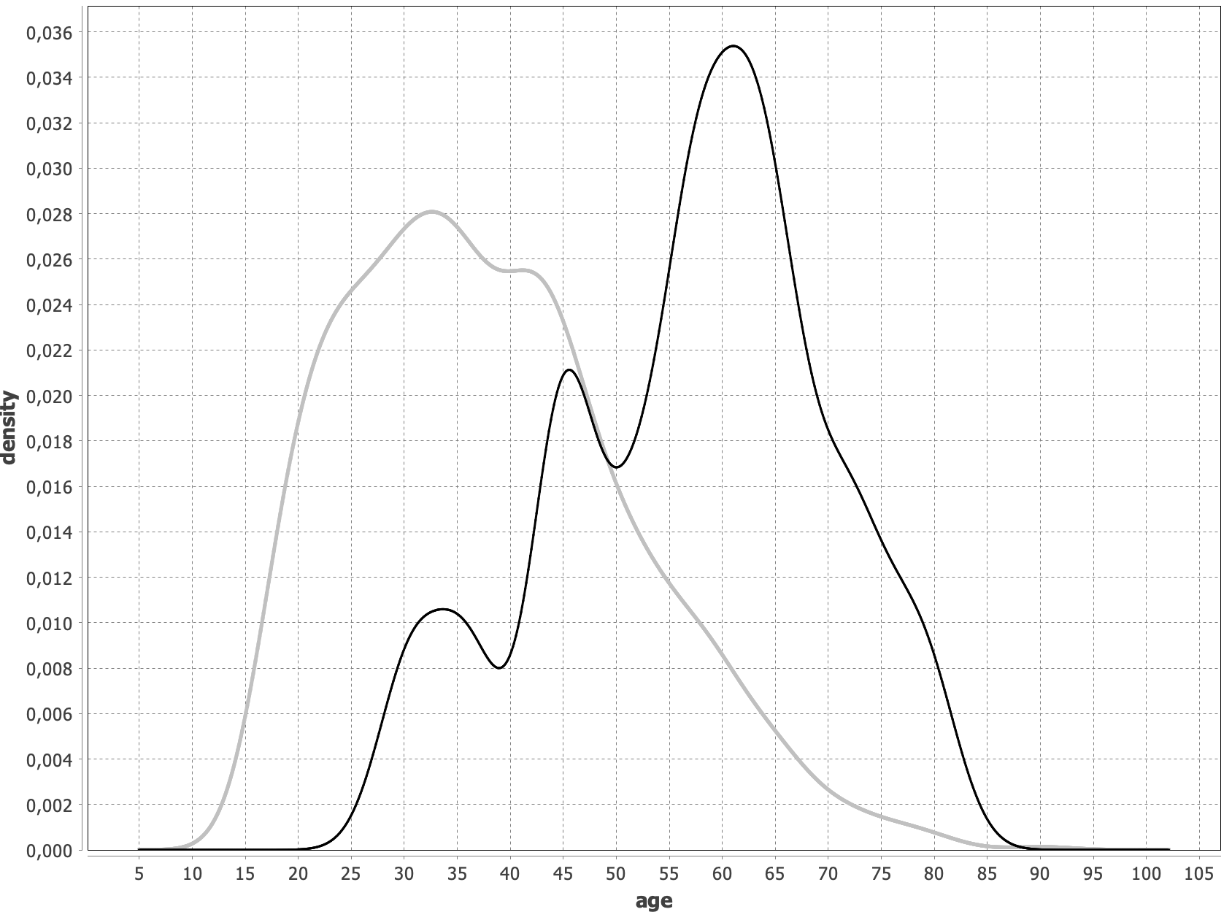
Subgroup-based KDE
entire population
widowers (3.3%)

Slide 16
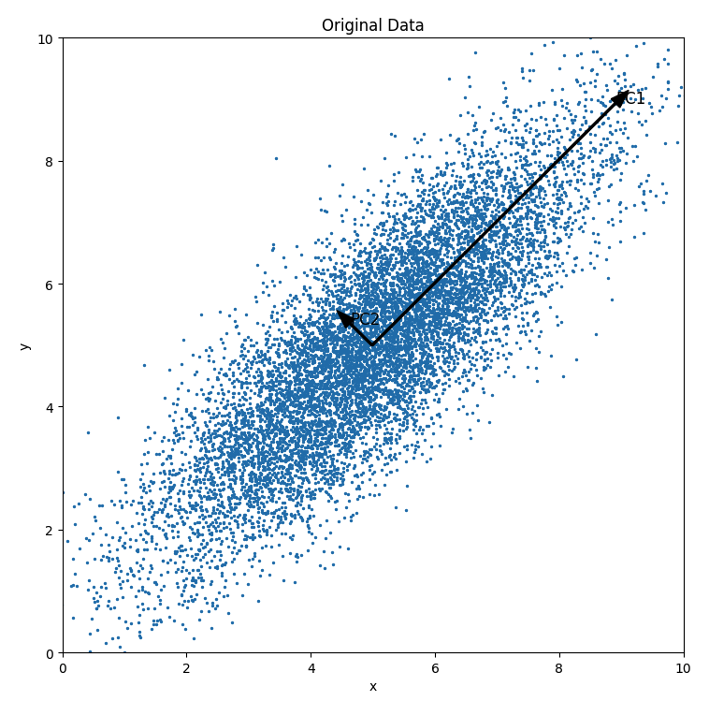
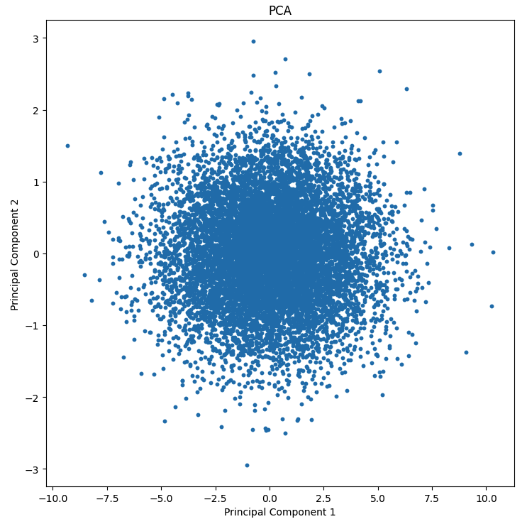
Principal Component Analysis (PCA)

Slide 17
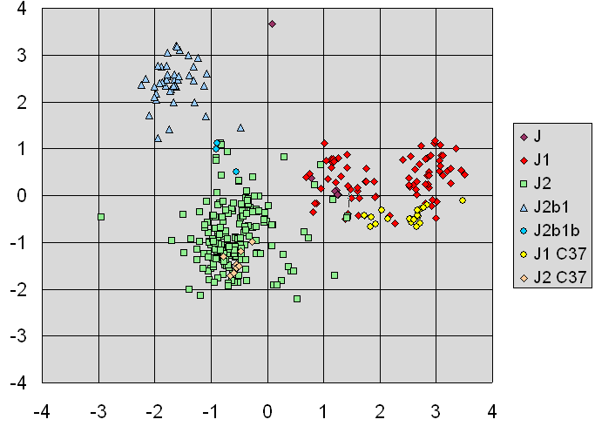
Principal Component Analysis
Linear dimensionality reduction technique
Data projected onto a new coordinate system
  linear combination of original features
  principal components are orthogonal
  components ordered by largest variance
    first component has largest variance, second (perpendicular) component has largest remaining variance, …
  dimensionality reduction by selecting the first k components
Unsupervised approach
  not optimised for class-separability
Notes:
Source: https://en.wikipedia.org/wiki/Principal_component_analysis

Slide 18
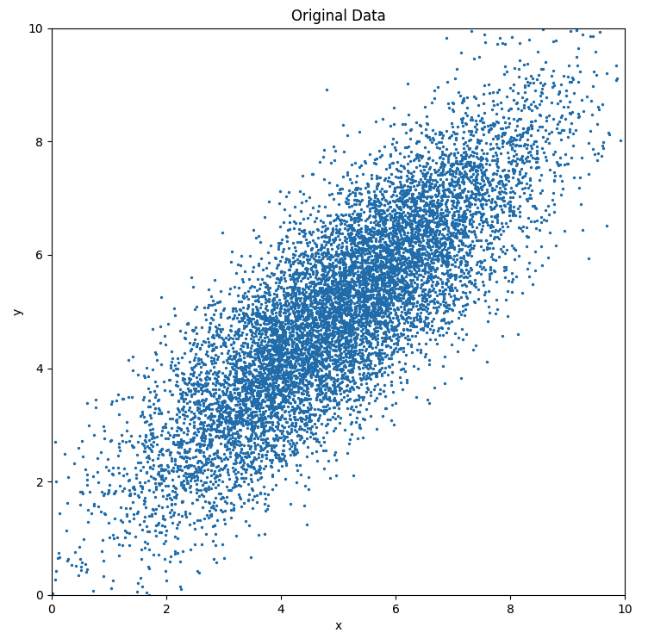
Principal Component Analysis
from sklearn.decomposition import PCA
mean = [5, 5]
covariance_matrix = [[3, 2.5], [2.5, 3]]
num_samples = 10000
samples = np.random.multivariate_normal(mean, covariance_matrix, num_samples)
pca = PCA(n_components=2)
X_pca = pca.fit_transform(samples)
print(pca.explained_variance_)
print(pca.explained_variance_ratio_)
explained variance: (5.401, 0.501)
explained variance ratio: (0.917, 0.082)

Slide 19
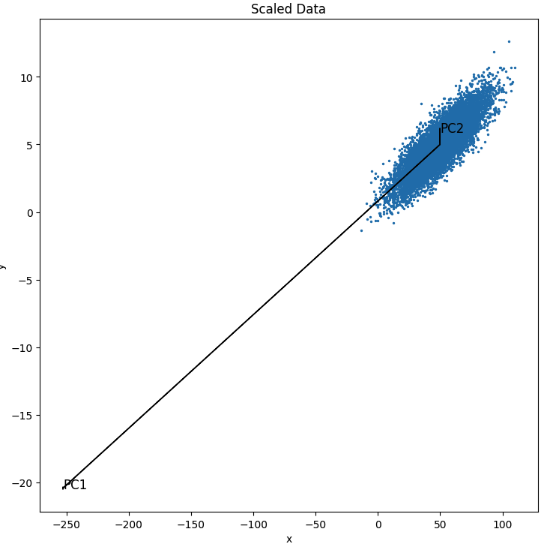
PCA on Scaled Data
(x = x*10)
When features are on different scales (e.g., one feature in km, another in mm)
Variance of larger-scaled feature will dominate the PCA process
from sklearn.preprocessing import StandardScaler
# With scaling (mean=0, std=1)
scaler = StandardScaler()
X_scaled = scaler.fit_transform(X)
X_pca_scaled = pca.fit_transform(X_scaled)
Notes:
StandardScaler does a z-transform

Slide 20
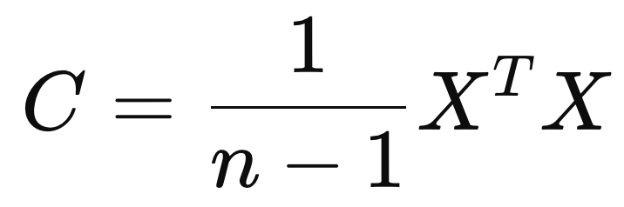
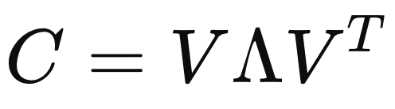
Principal Component Analysis
(Standardize the data)
Compute the covariance matrix C:
Decompose C into its eigenvectors and eigenvalues
Sort according to eigenvalues, and select the top components
Different implementations:
  svd_solver = ‘auto’
  svd_solver = ‘full’
  svd_solver = ‘covariance_eigh’
  svd_solver = ‘randomized’
eigenvalues
eigenvectors
different solvers, each with their particular reasons to choose (size of data, stability, …)
Notes:
eigenvector = direction of the components
eigenvalue = amount of variance captured by each component

Slide 21
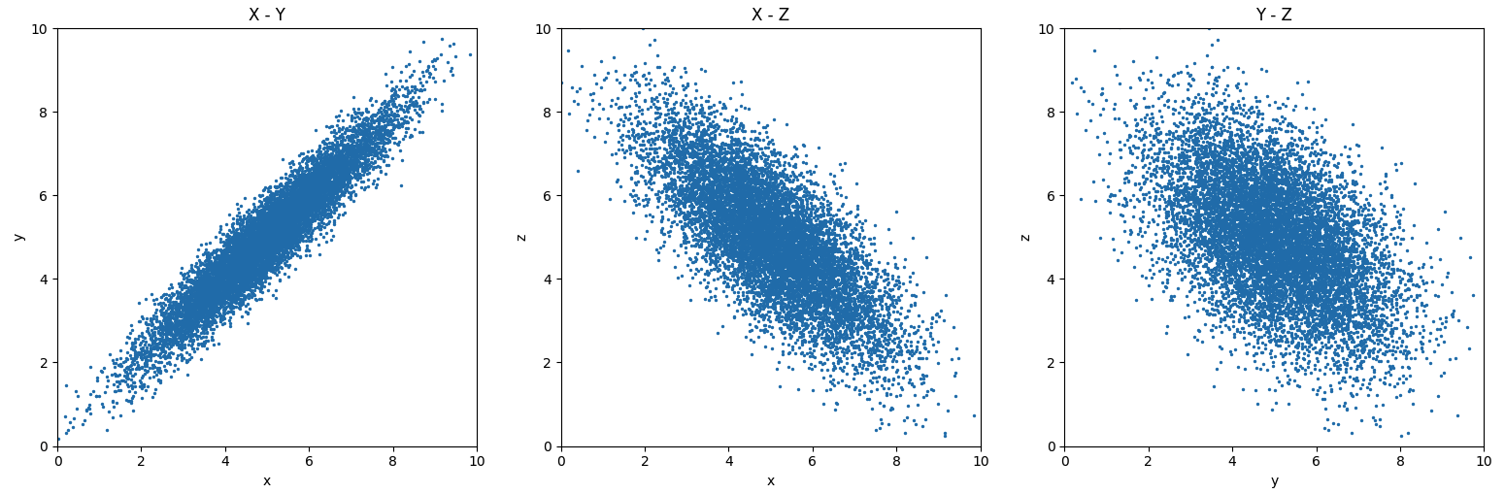
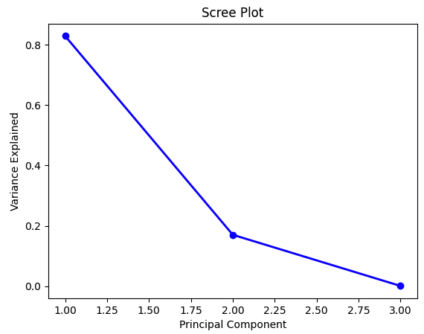
PCA Scree Plot

Slide 22
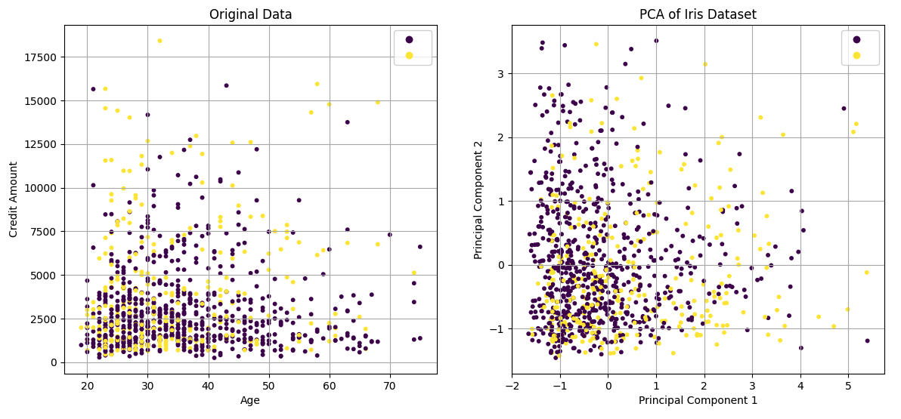
PCA Properties
Results of PCA depends on scaling of variables
  z-transform the data first
Tacit assumptions about linearity
Unsupervised (no target)
Mean-removal may be annoying
Interpretation of Principal components
German credit data
Age, Credit Amount, Lone Duration

Slide 23
Break

Slide 24
t-distributed Stochastic Neighbor Embedding
(t-SNE)

Slide 25
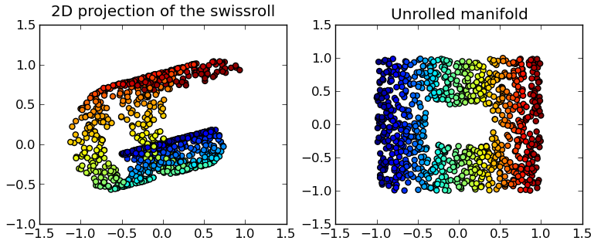
Non-linear Dimensionality Reduction
Manifold
Intrinsic lower dimensionality

Slide 26
t-SNE Approach
Represent distances between every pair of datapoints
  in the high-dimensional space
  in the low-dimensional space
Compute the divergence between the two
Move the points in the low-dimensional space
  lower the divergence

Slide 27
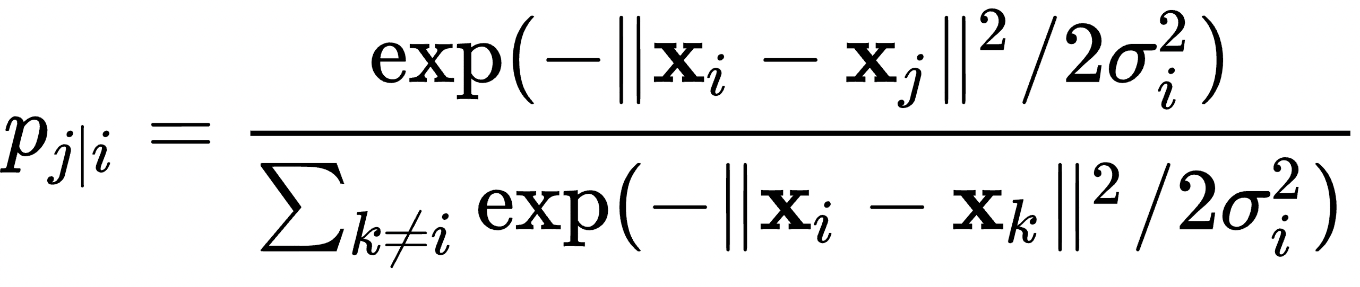
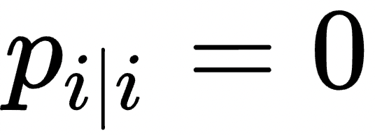
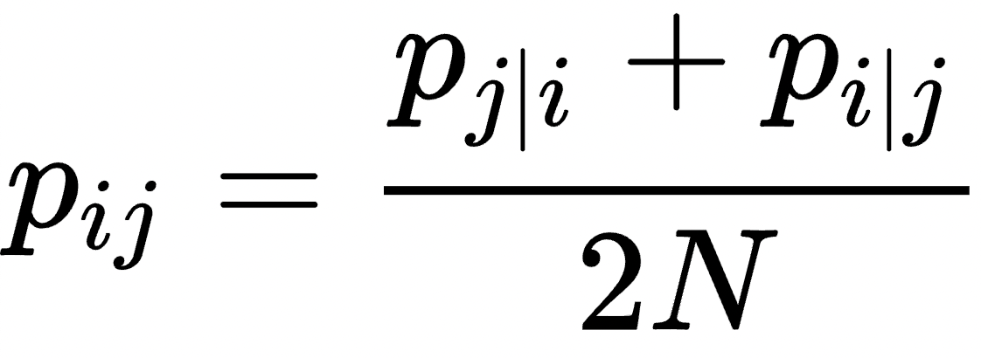
Quantify Similarity in High-dimensional Space
Express similarity between points as probabilities
, but
Not symmetric, so
(scaled)
Gaussian
weight by the sum,
such that sum of
p_{j|i} equals 1
Hinton, Roweis, Stochastic Neighbor Embedding,
Advances in Neural Information Processing, 2002

Slide 28
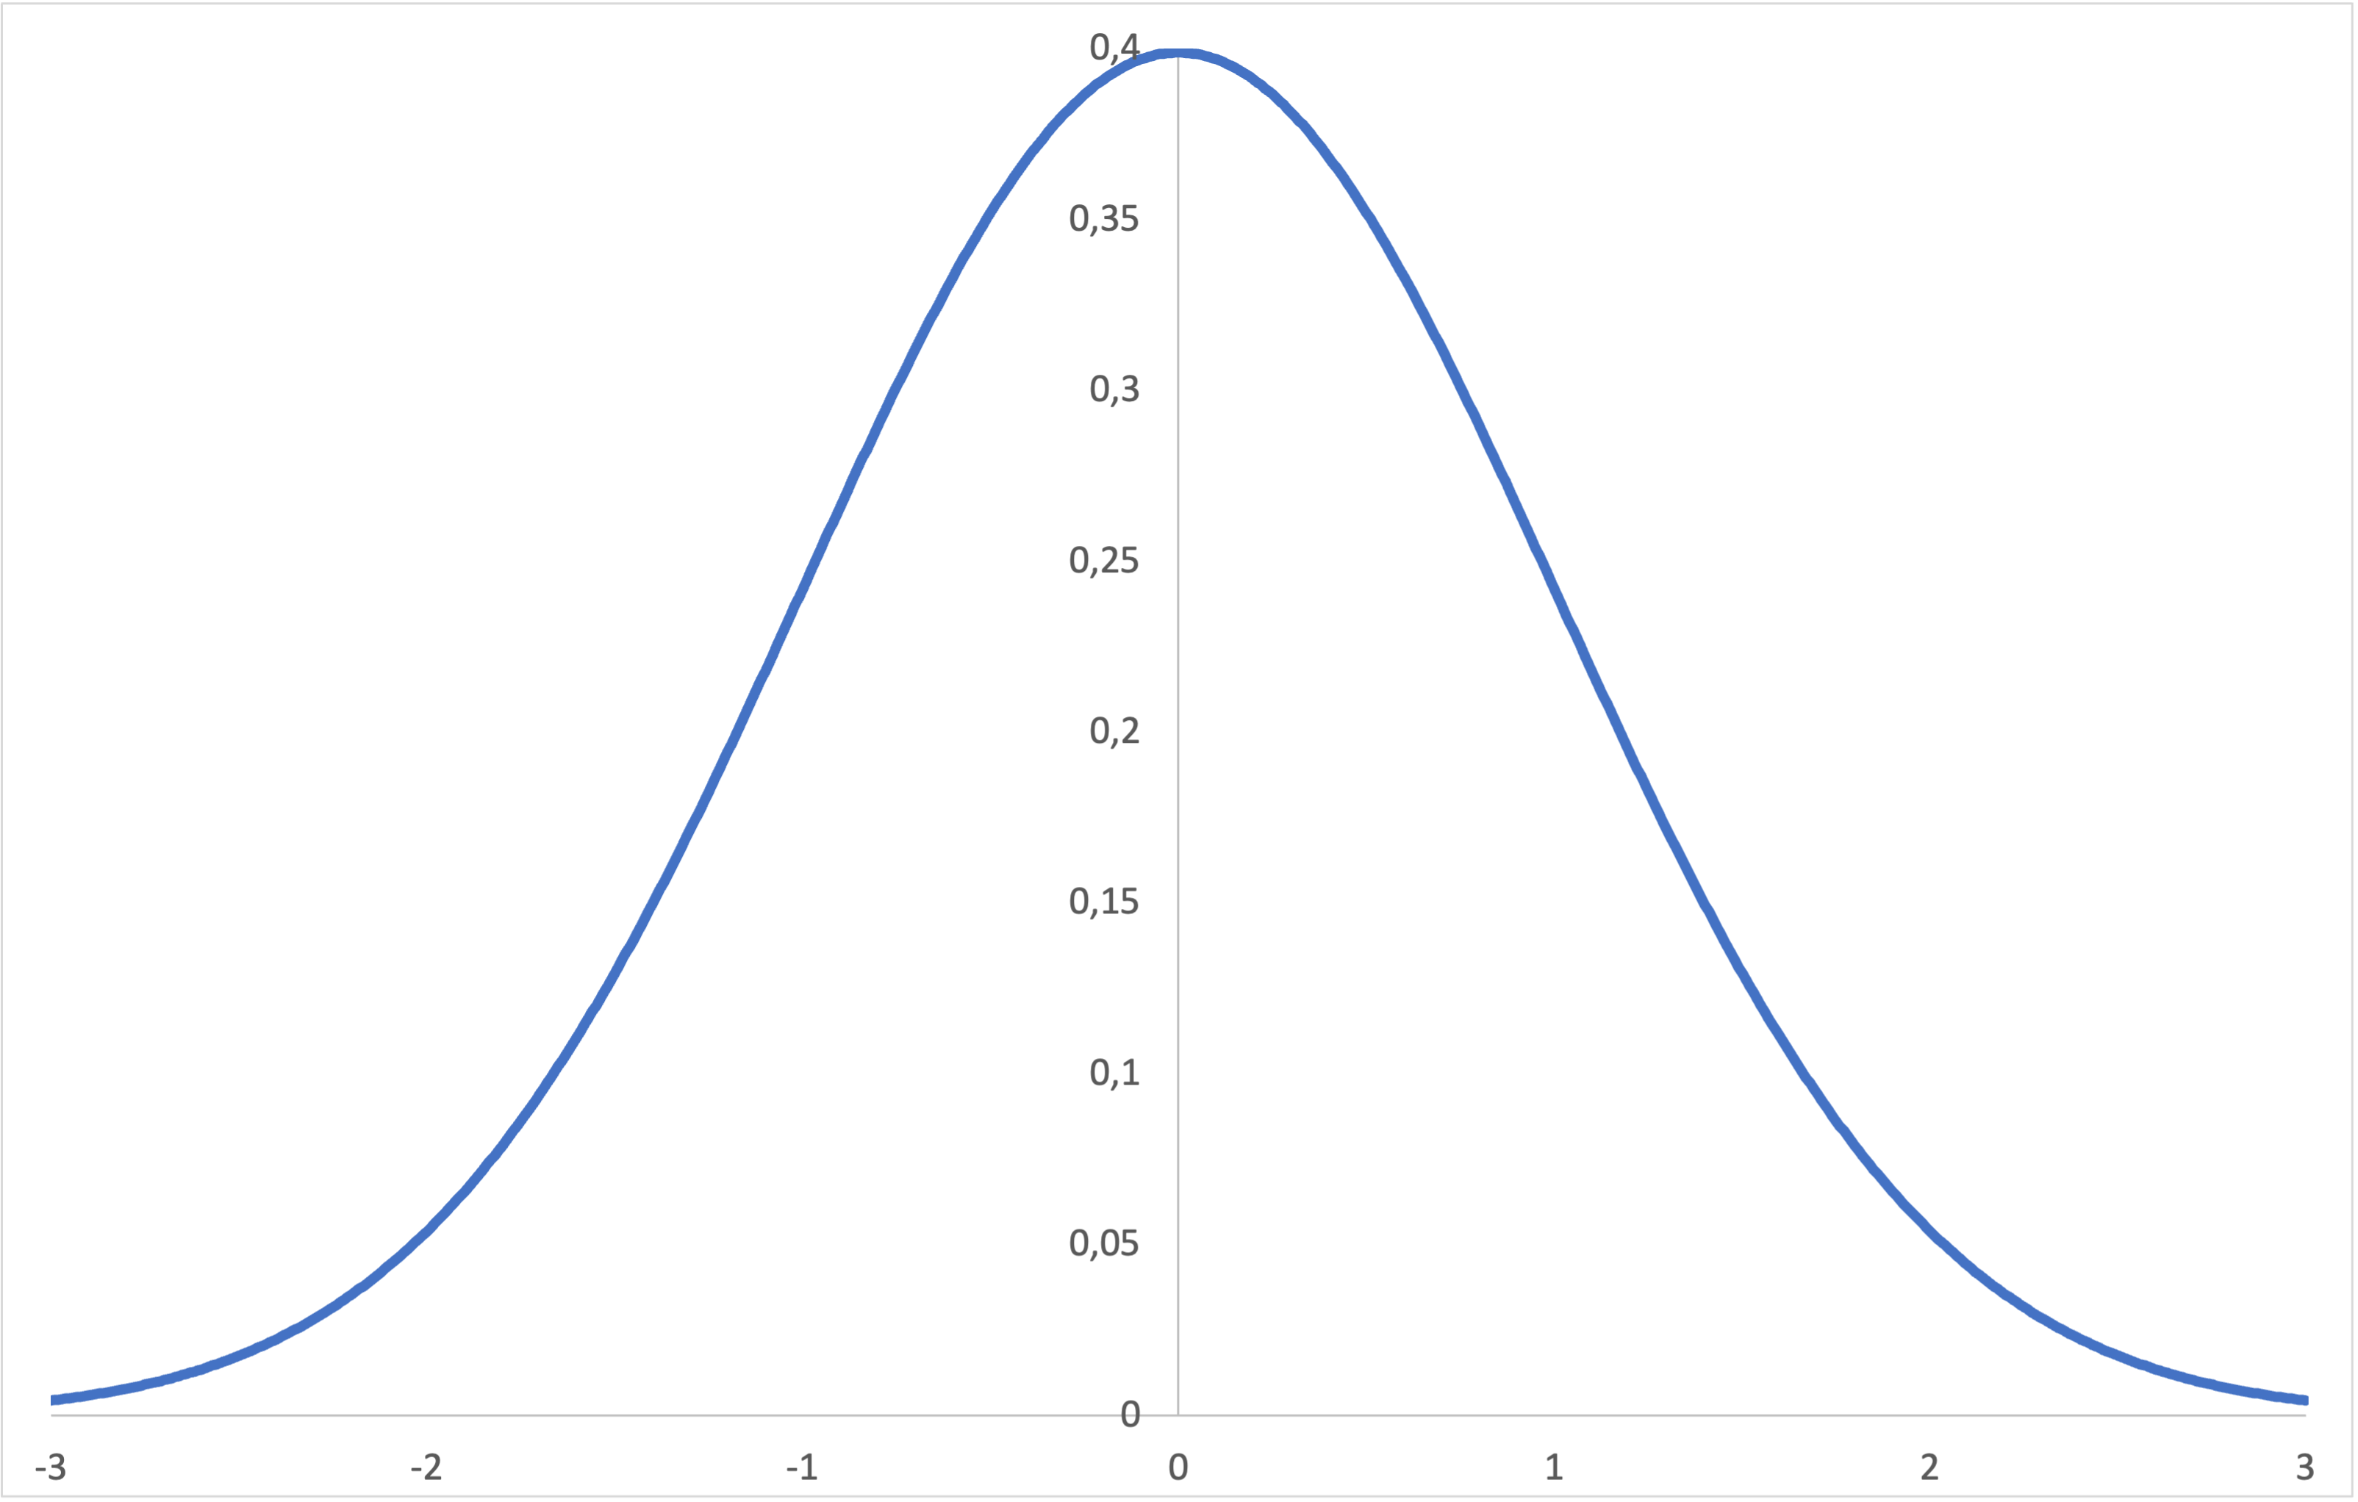
Gaussian around Point i
Gaussian captures notion of neighbourhood
Nearby points get high probability, far away deminish to 0
distance to i

Slide 29
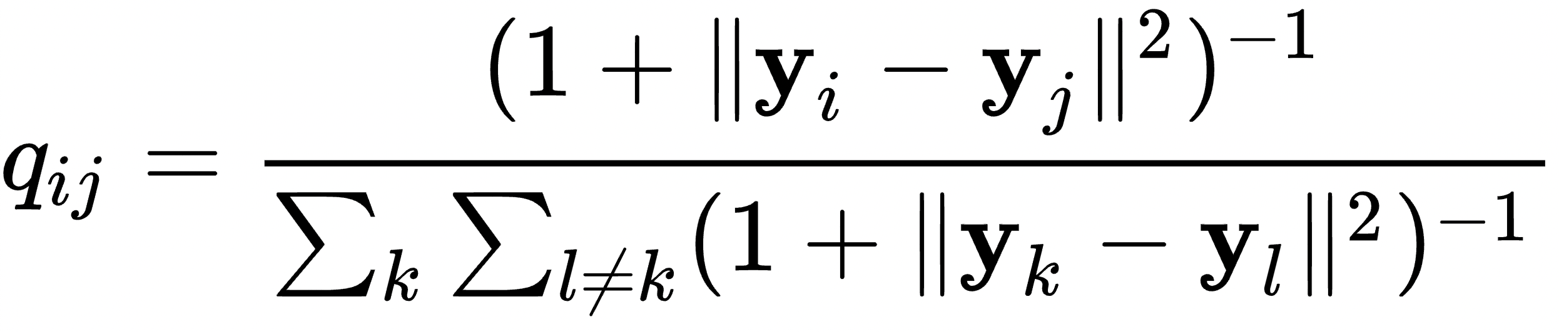
Quantify Similarity in Low-dimensional Target Space
Student’s t-distribution, heavy-tailed
Improvement of t-SNE compared to original SNE
van der Maaten, Hinton. Visualizing High-Dimensional Data
Using t-SNE. Journal of Machine Learning Research 9, 2008

Slide 30
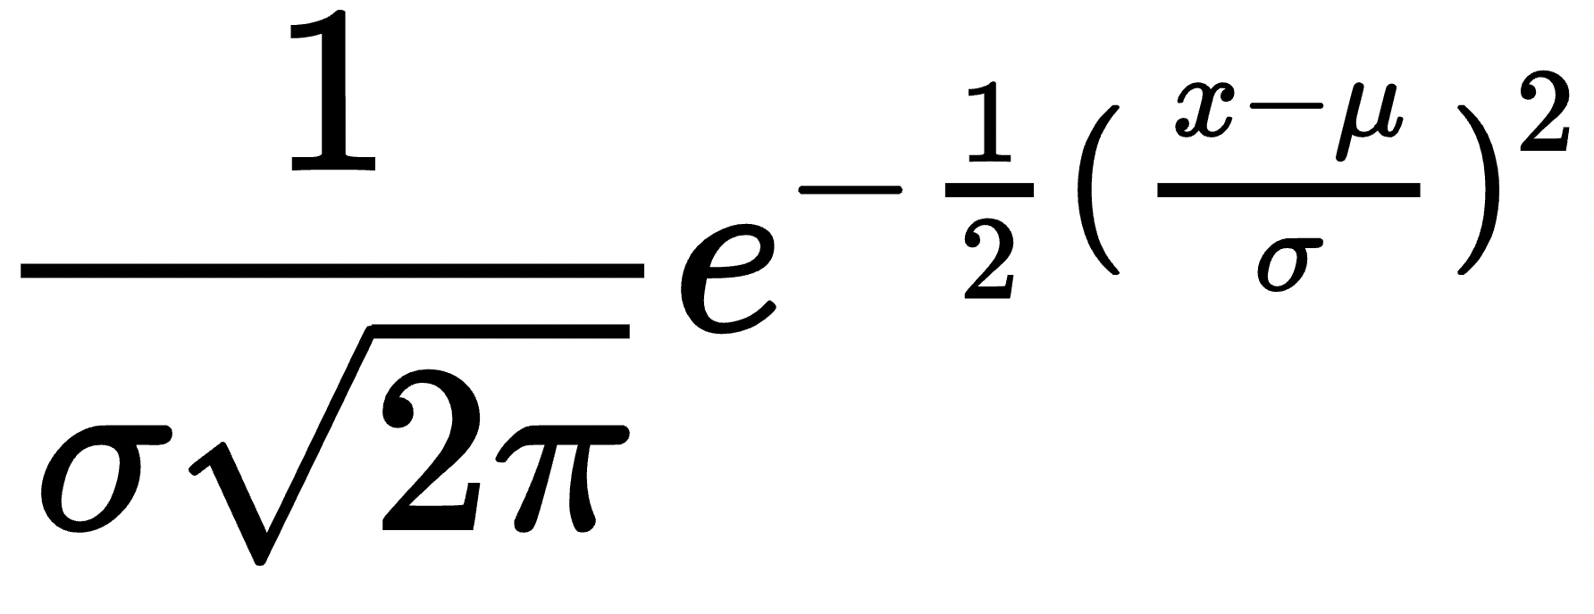
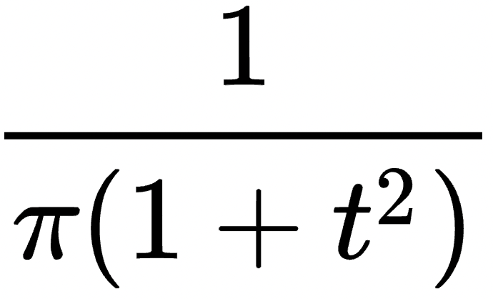
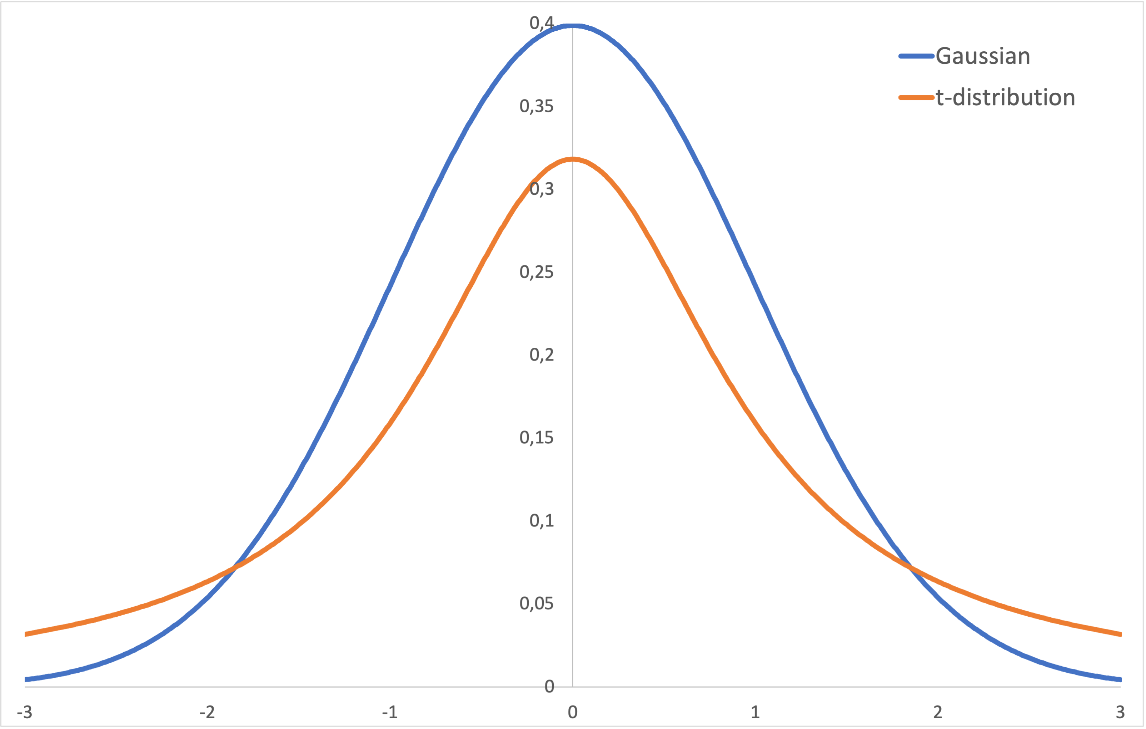
Gaussian vs. t-Distribution
Gaussian:
t-Distribution (1 degree of freedom):
Similar bell-shaped, symmetric curve
T-distribution has a thicker tail

Slide 31
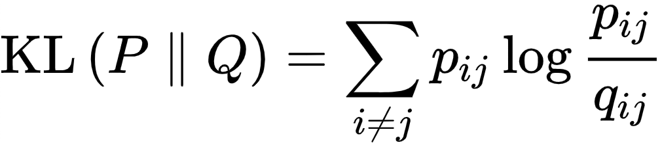
Comparing Two Probability Distributions
Minimizing the sum of the Kullback-Leibler divergences between the conditional probabilities
Kullback–Leibler divergence is a type of statistical distance: how one distribution P is different from a second distribution Q
High-dimensional similarity
Low-dimensional similarity
x₀
y₀
x₁
y₁
KL(P || Q)
minimize
x₀
x₁
y₀
y₁

Slide 32
Comparing Two Probability Distributions
High-dimensional similarity
Low-dimensional similarity
x₀
y₀
x₁
y₁
KL(P || Q)
minimize
x₀
x₁
y₀
y₁
P is fixed: similarities in high-dimensional space
Q is flexible: similarities in low-dimensional space
  depends on location of points in low-dimensional space
Gradient descent: move points in direction that minimizes KL
Local optimum

Slide 33
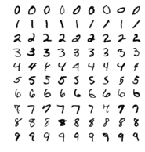
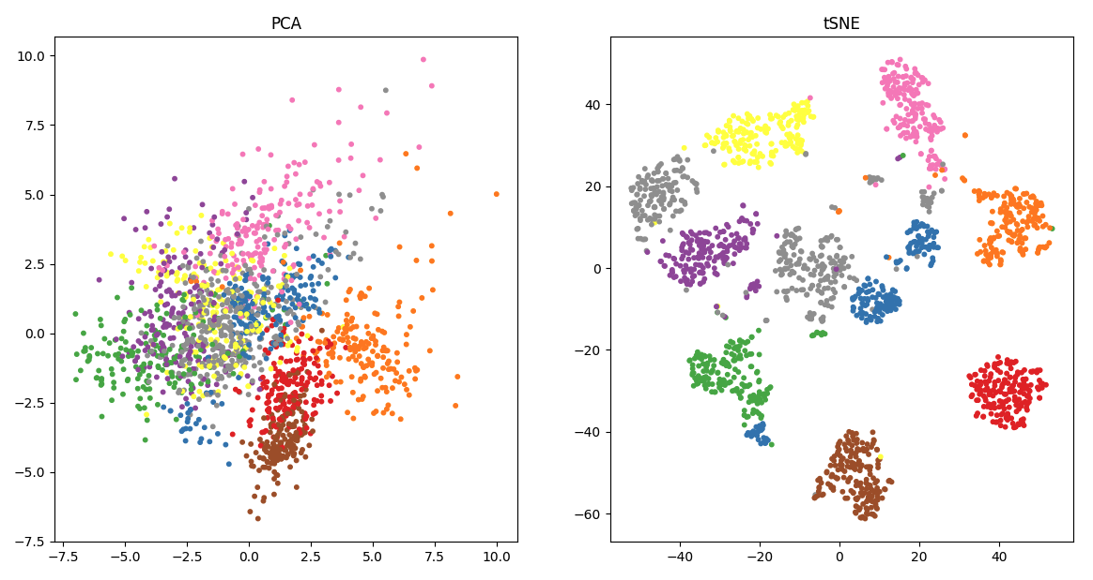
t-SNE on MNIST Dataset
Hand-written digit recognition
28x28 pixels
784 dimensions

Slide 34
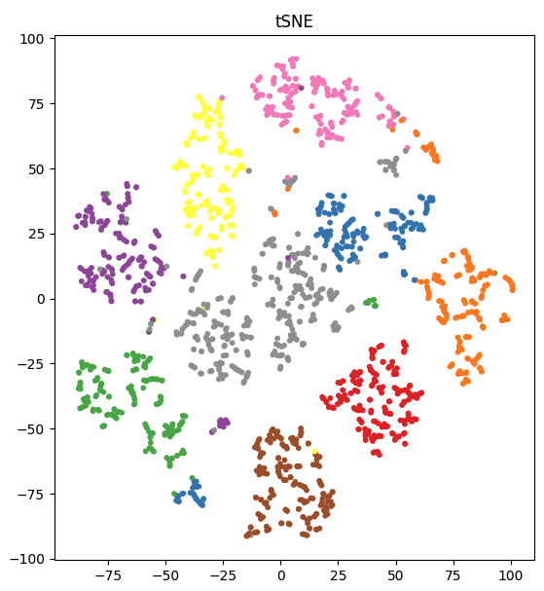
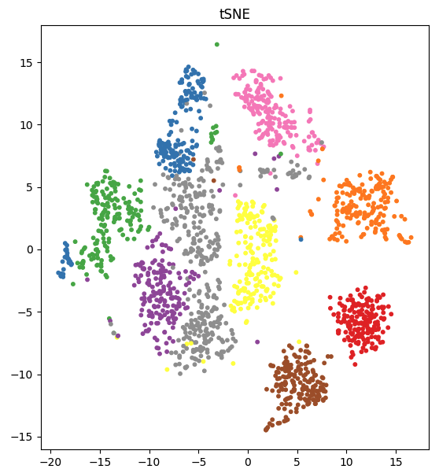
Perplexity
Perplexity affects balance between local and global structure
It defines the number of effective neighbours
Small Perplexity (5-30):
  fewer points as neighbours, focusing more on very local clusters
  can miss the larger global structure
Large Perplexity (e.g., 30-100):
  more points are considered as neighbours, giving a more global view of the dataset
  broader patterns, might smooth out finer details
perplexity=5.0
perplexity=200.0

Slide 35
Properties
Non-linear mapping
Close points end up close in low-dimensional space
Proximity in low-dimensional space is no guarantee for original proximity
Good separation between clusters
No function is learned
  ‘only on the training set’
Local optimum
  re-run with different seed

Slide 36
Sklearn Implementation
sklearn.manifold.TSNE
n_components, default=2 Dimension of the embedded space
perplexity, default=30.0 Related to number of nearest neighbours
max_iter, default=None Max number of iterations for optimisation
init{‘random’, ‘pca’} Initialisation of embedding
random_state, default=None Determines the random number generator
e.g.
X, y = datasets.load_digits(return_X_y=True)
tsne = make_pipeline(StandardScaler(), TSNE(n_components=2, init='pca'))
tsne.fit(X, y)
X_tsne_2d = tsne.fit_transform(X)
plt.scatter(X_tsne_2d[:, 0], X_tsne_2D[:, 1])

